Slide 1


Sport Connect Product Updates
11.21.2024

Slide 2
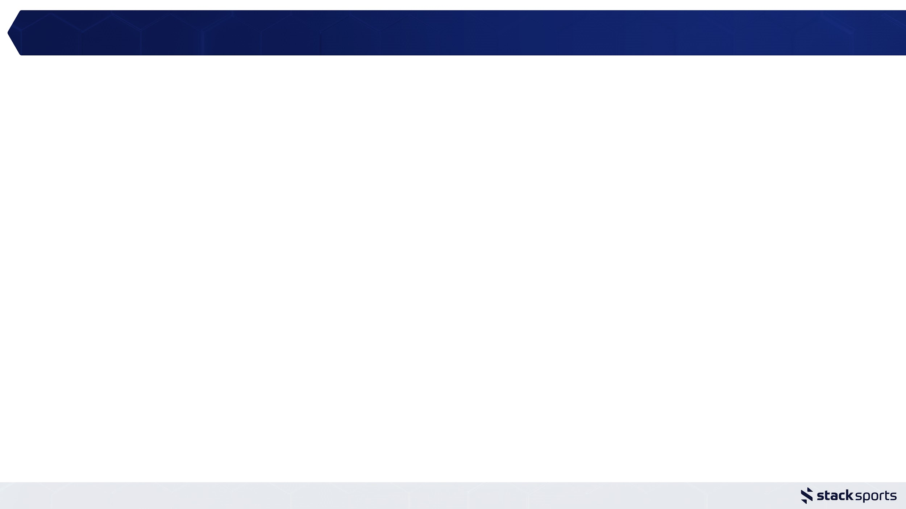
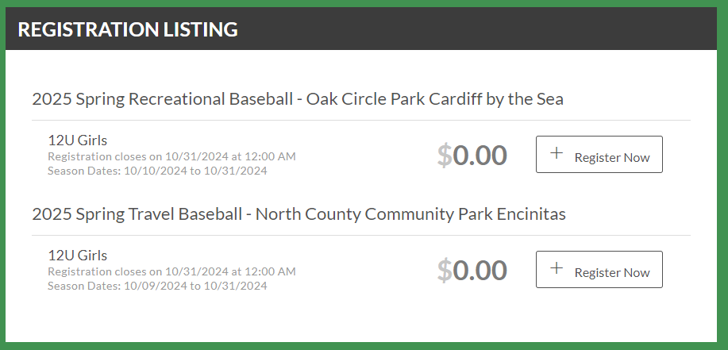
UXE | Character limitation 50 => 100 Program, Division names | 10.2
Character limitations in Program and Division names created a lot of issues for partners that among other things may need to include a location name. More often than not, activity + age group + location will exceed the previously capped 50. The character limitation has now been increased to 100.

Slide 3
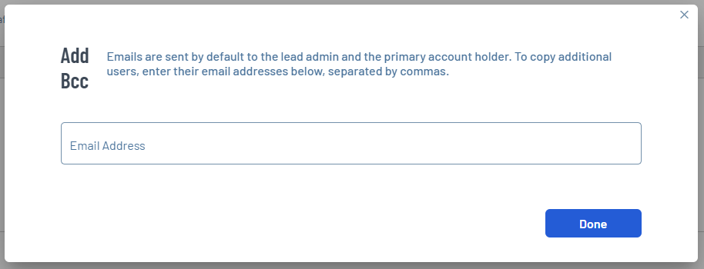
UXE | Eyes on the BCC for Confirmation Notes | 10.2
the copy below the header has been updated with ‘Use the BCC feature to copy additional email addresses.’
the copy in the popup now reads ‘To copy additional users, enter their email addresses below, separated by commas.’

Slide 4
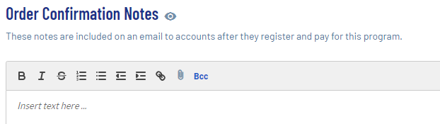
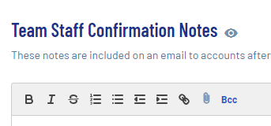
UXE | UXE | Eyes on the BCC in the Confirmation Notes setup | 10.2
the BCC has been bolded and is now blue to be a tad bit more noticeable

Slide 5
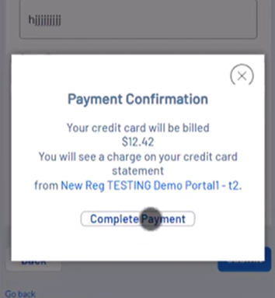
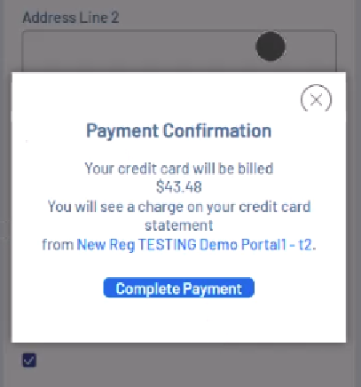
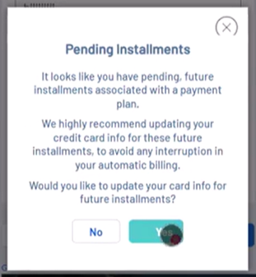
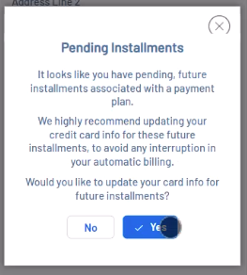
UXE | Updated payment confirmation button | 10.2
"Payment Confirmation - Your credit card will be billed $XXX.XX. You will see a charge on your credit card statement from Club XX."
Different than other CTA buttons, ‘Complete Payment’ was white, thus easily missed. According to partner feedback:
“Nobody gets that you have to press the button to complete and they send me
this screenshot saying they paid. All other action buttons are blue.”

Slide 6
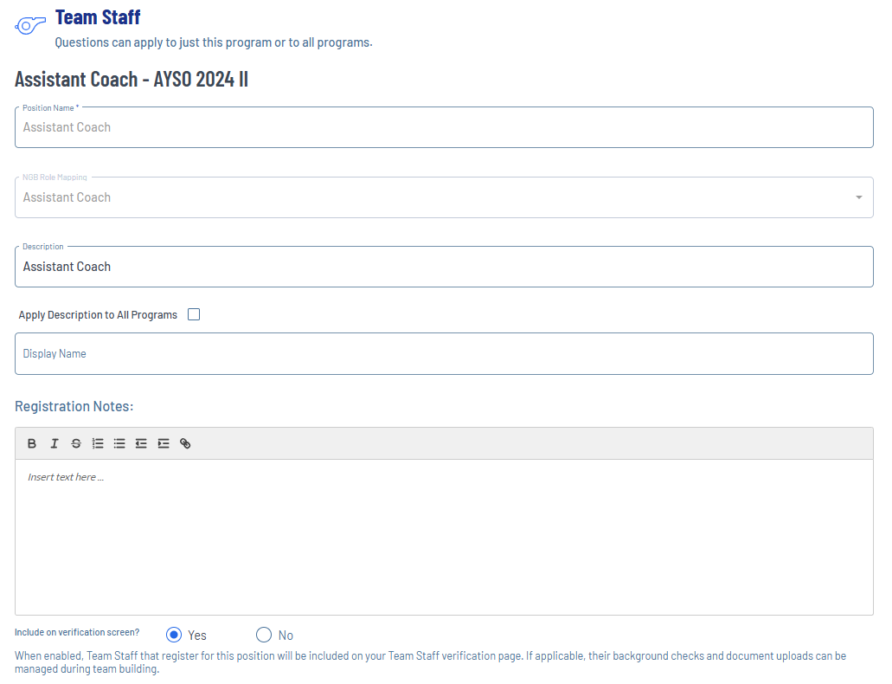
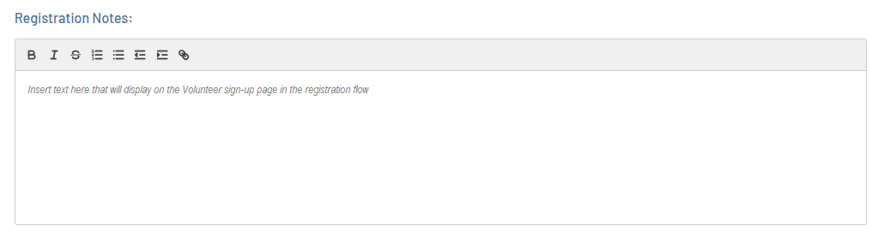
volunteers
UXE | Configurable Admin/Volunteer Registration Info | 10.2

Slide 7
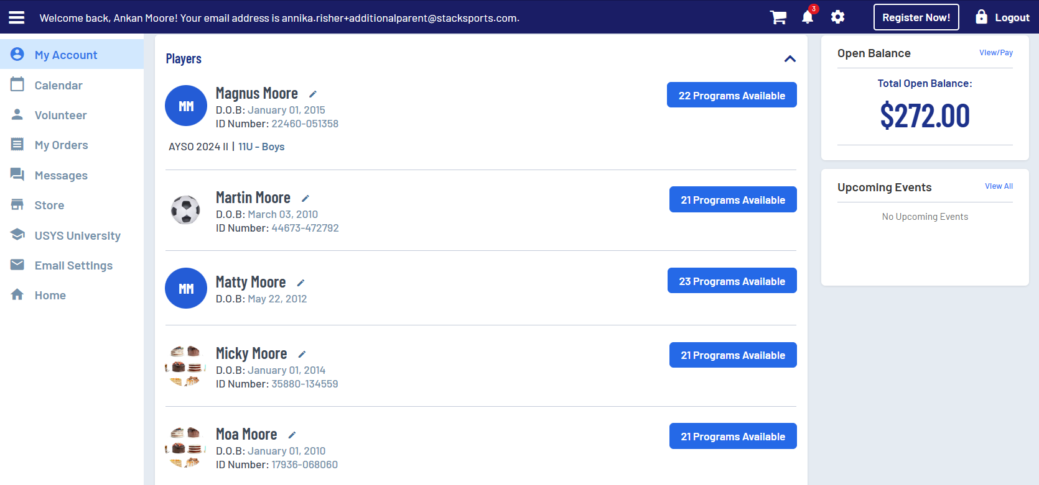
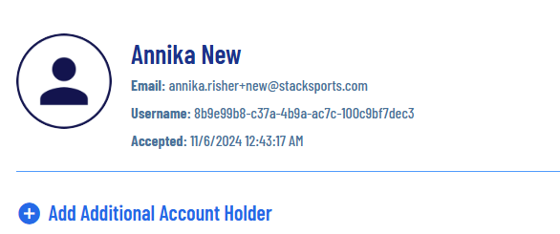
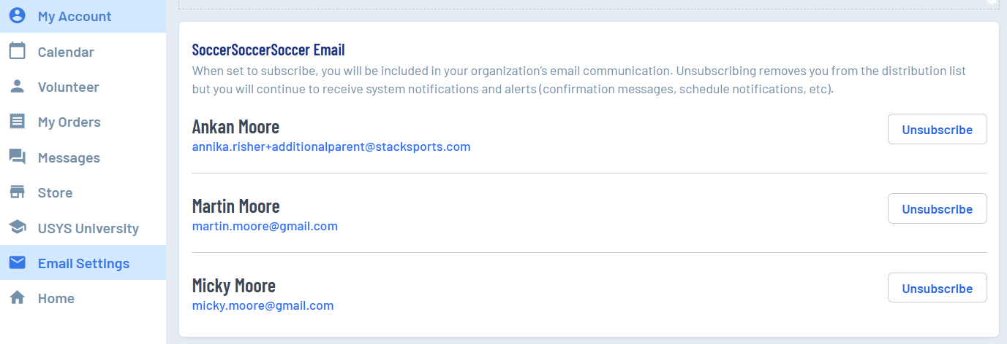
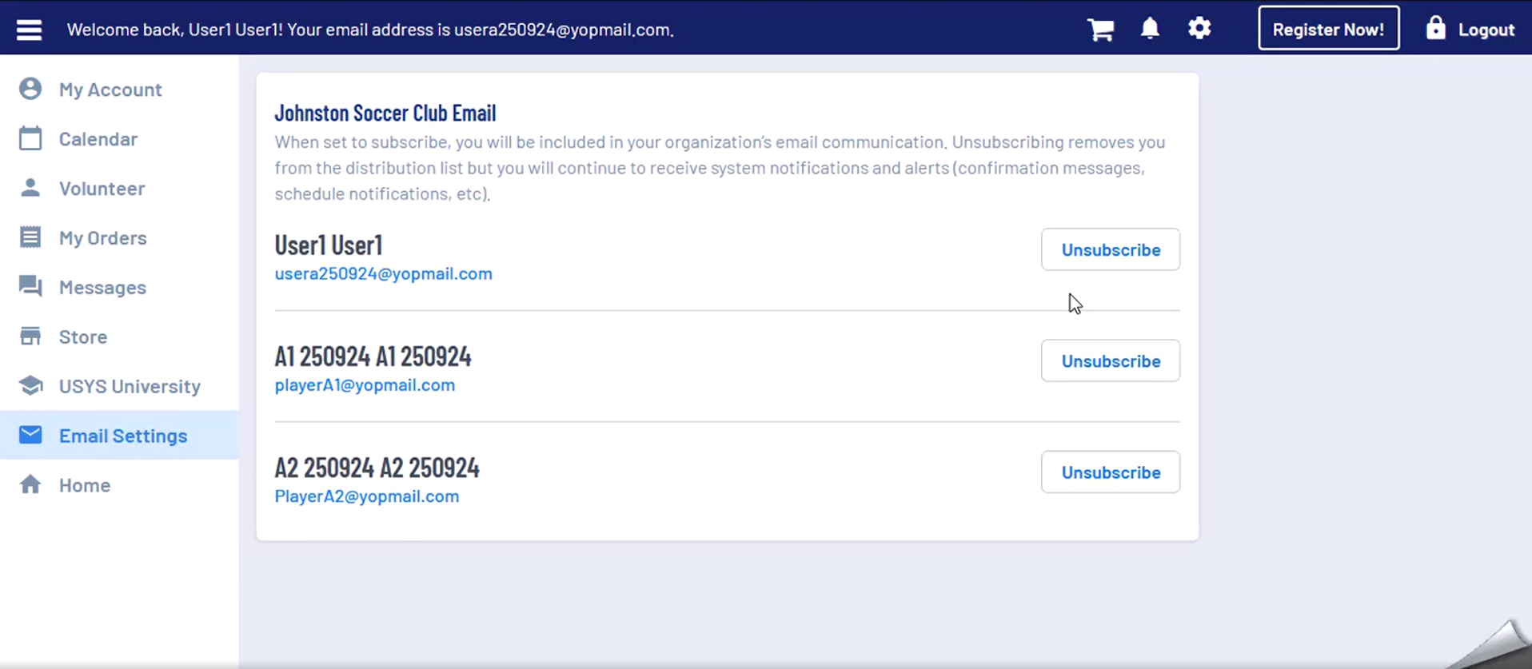
Manage Bulk Email subscription on My Account | 10.16

Slide 8
UXE | Bulk Email drafts, auto save | 10.28
Problem Statement: users expect the ability to save a draft while creating an email – both to mitigate the effects of system time outs and because they may want to not complete it all in one sitting.

Slide 9
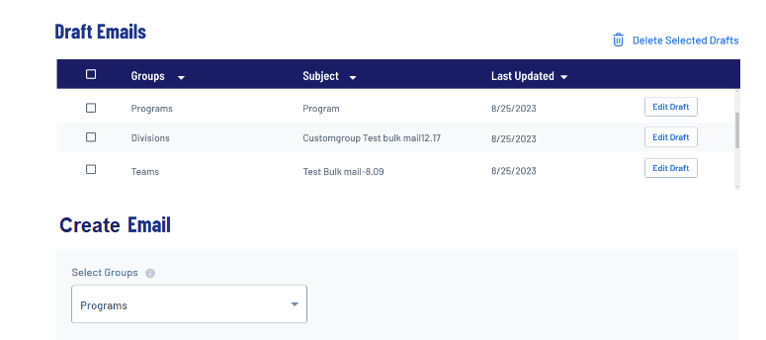
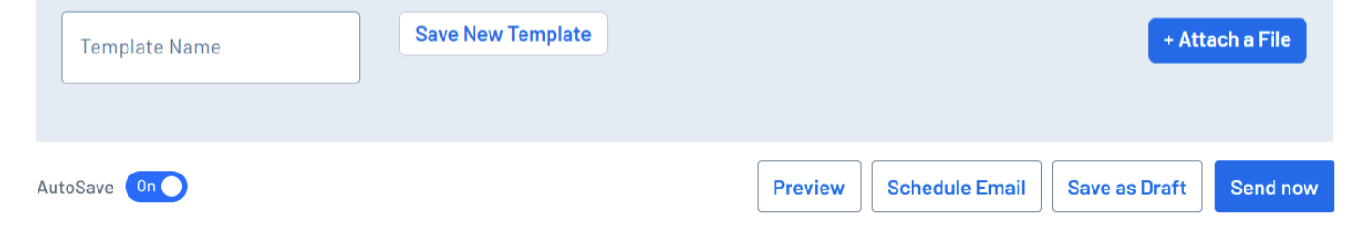
UXE | Bulk Email drafts, auto save | 10.28

Slide 10
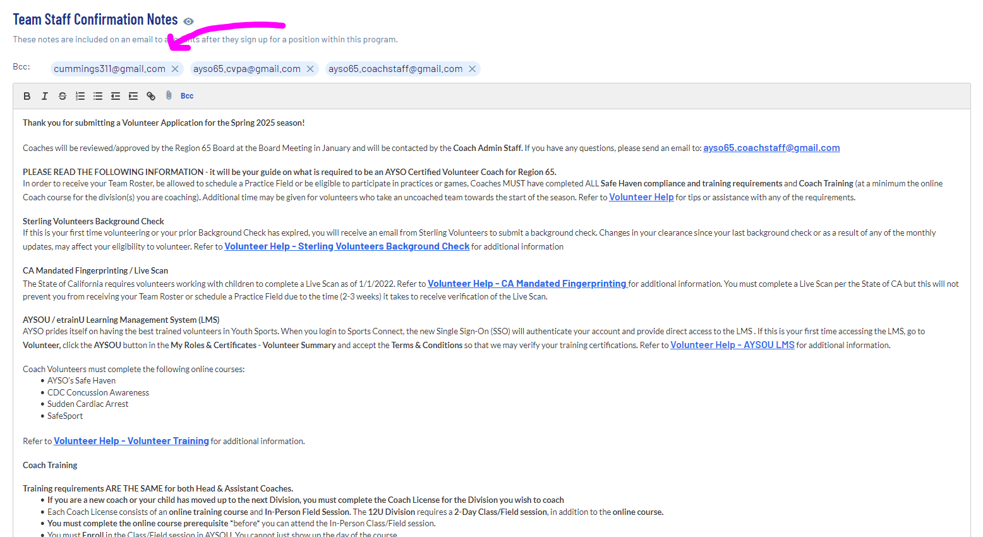
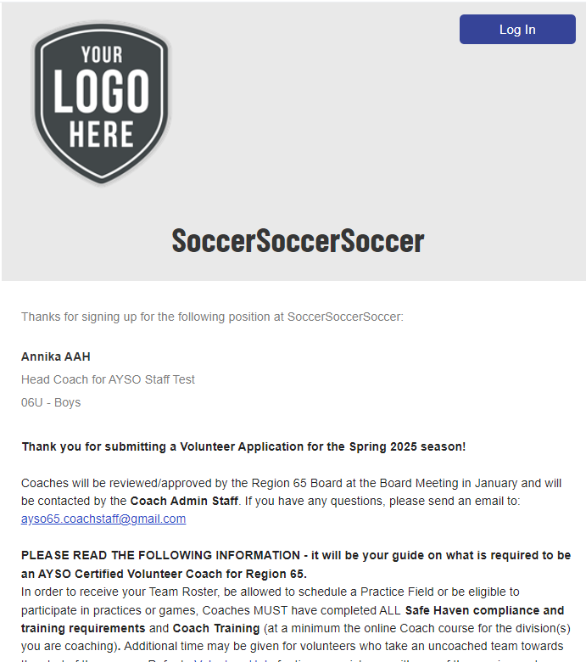

New AAH: post-verification registration confirmation | 10.28
Yes, Region 65 is also using the BCC feature!

Slide 11
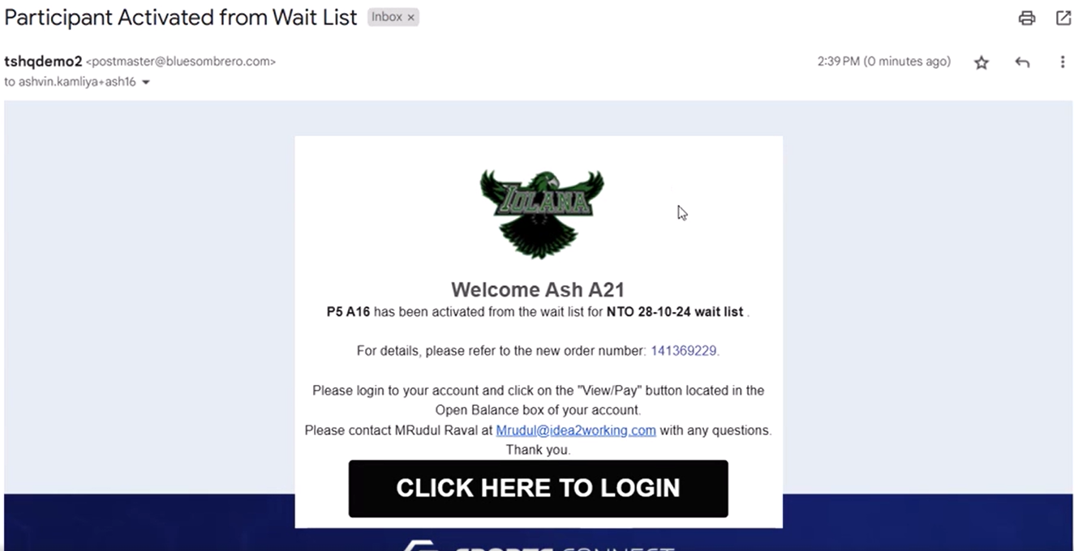
UXE | Waitlist Activation email linking to new order payment | 10.28

Slide 12
Bulk Email | updates
10.28: both primary + secondary emails now included in Volunteer Roles audience
11.13: a player’s verified AAH’s included in Teams audience
Spike: define audience details
January: Bulk Email page link to support article
Problem Statement: there is not detailed information regarding who is included in the various audience options in Bulk Email. This is causing confusion (and escalations) both externally and internally.
provide specifics on users/members/statuses included in the various bulk email audience options
separately, add this info to the UI (coming soon)

Slide 13
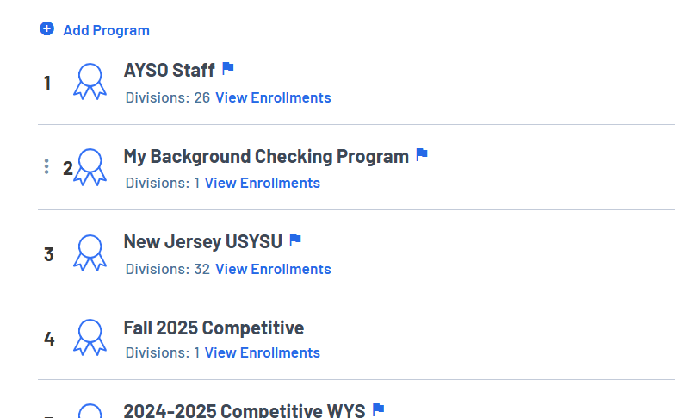
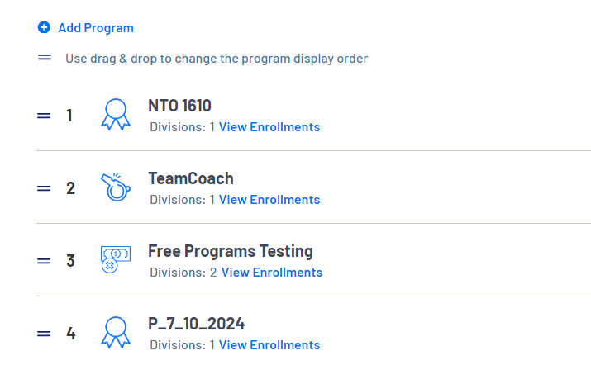
UXE | Controlling the program display order | 11.13
Legacy UX: Enhanced UX:

Slide 14
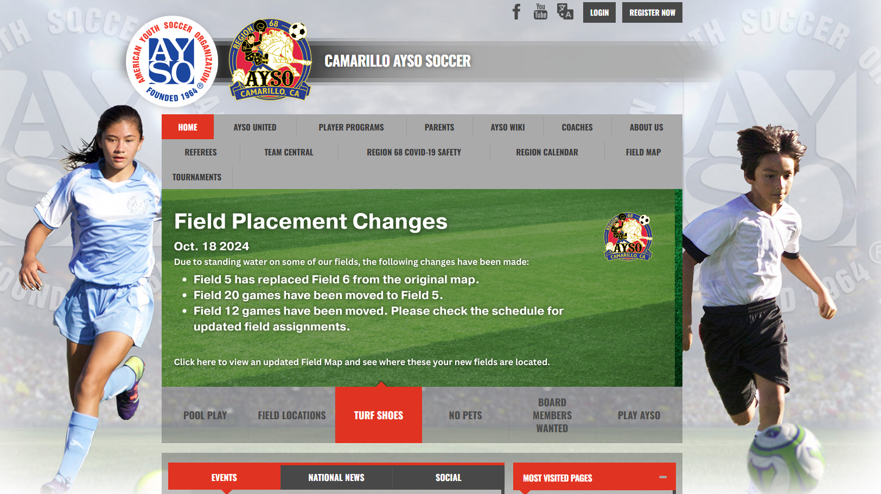
UXE | Rotator headlines made optional | 11.13
Many regions use images with embedded text

Slide 15
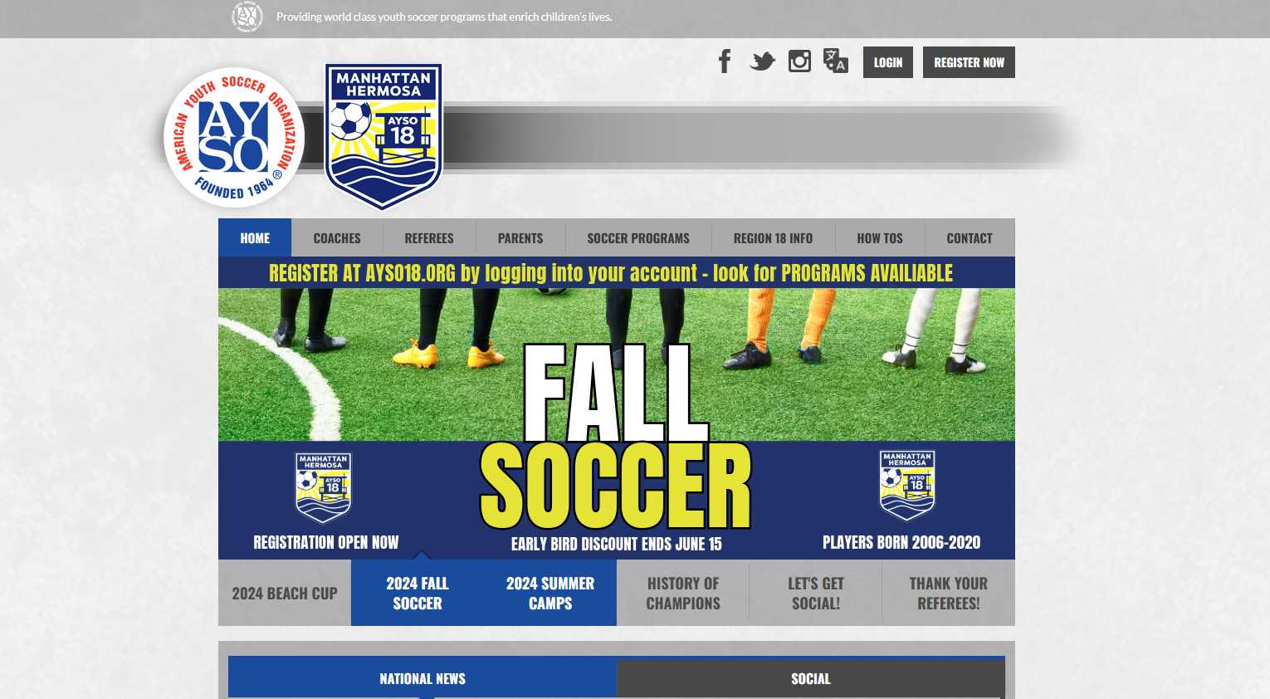
UXE | Rotator headlines made optional | 11.13
No headlines = existing artwork will fit new ‘Modern’ themes

Slide 16
Additional releases | Enhancements & Fixes
9.4: Max Number of Players required field enforced
9.4: Issue updating future payment plan installments resolved
9.18: Teams with no Posted Scores added to Standings page
9.18:Games Remaining (GR) column added to Standings table
9.18:AYSOU API | Passing DOB and zip code data to etrainu
10.2: Account holders are correctly notified when new messages are received in My Account
10.2: Right/left content module misalignment corrected on legacy AYSO theme
10.2: Enrollment Details report issue addressed
10.2: Sharing a report more than once now works as expected
10.2: Gear shopping cart text alignment correction
10.2: Team Personnel record listing correctly in Team Builder
10.2: Umbrella Schedule Event Reminder email linking to child portal

Slide 17
Additional releases | Enhancements & Fixes
10.16: Ability to allocate fields to Sitewide Events
10.16: Coupon loading error resolved
10.16: Imported Umbrella Schedules email notification multiplication issue corrected
10.16: Email delivery issue of large reports resolved
10.28: Filter option added to column headers on Scores page
10.28: Location now displayed for Site Wide Events on Google Calendar
10.28: Correct email content prepopulates in Waitlist removal confirmation page
10.28: Bulk Email: both primary + secondary emails now included for Volunteer Roles audience
10.28: Swap Game issue corrected
11.13: Coupon display list is correctly sortable by Created Date
11.13: Load error on Step 7 of Schedule Builder corrected
11.13: Correct Club Details now pulling into Order Confirmation email

