Slide 1
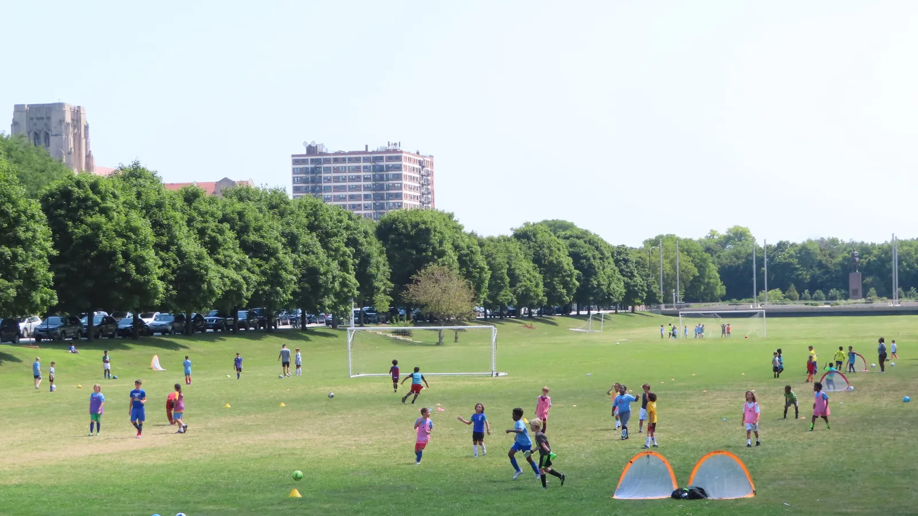

AYSO Parent Introduction

Slide 2
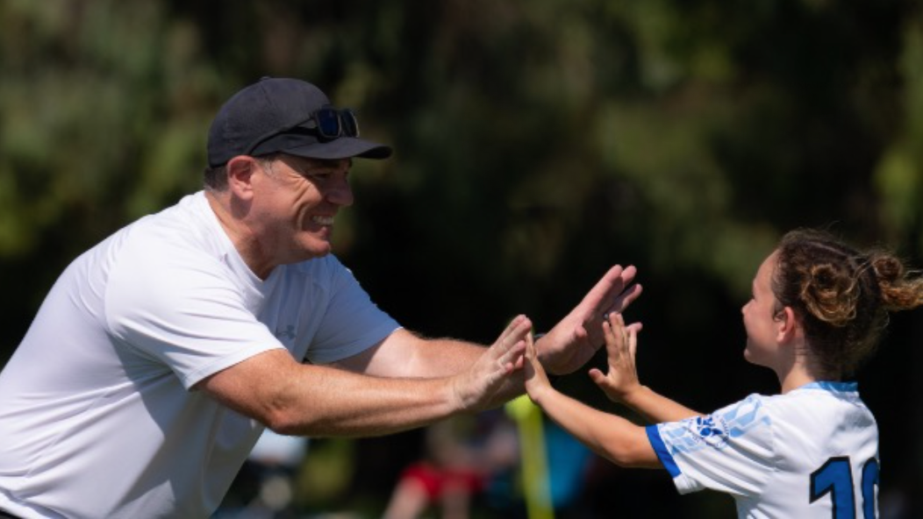
AYSO is…
A youth soccer organization that enriches children's lives through creative play environments based on the AYSO Philosophies: Everyone Plays. Balanced Teams. Open Registration. Positive
Coaching. Good Sportsmanship. Player Development.
Focused on fun, belonging, and development
Designed to help children grow both on and off th field
Powered by families, coaches, referees, and volunteers working together

Slide 3
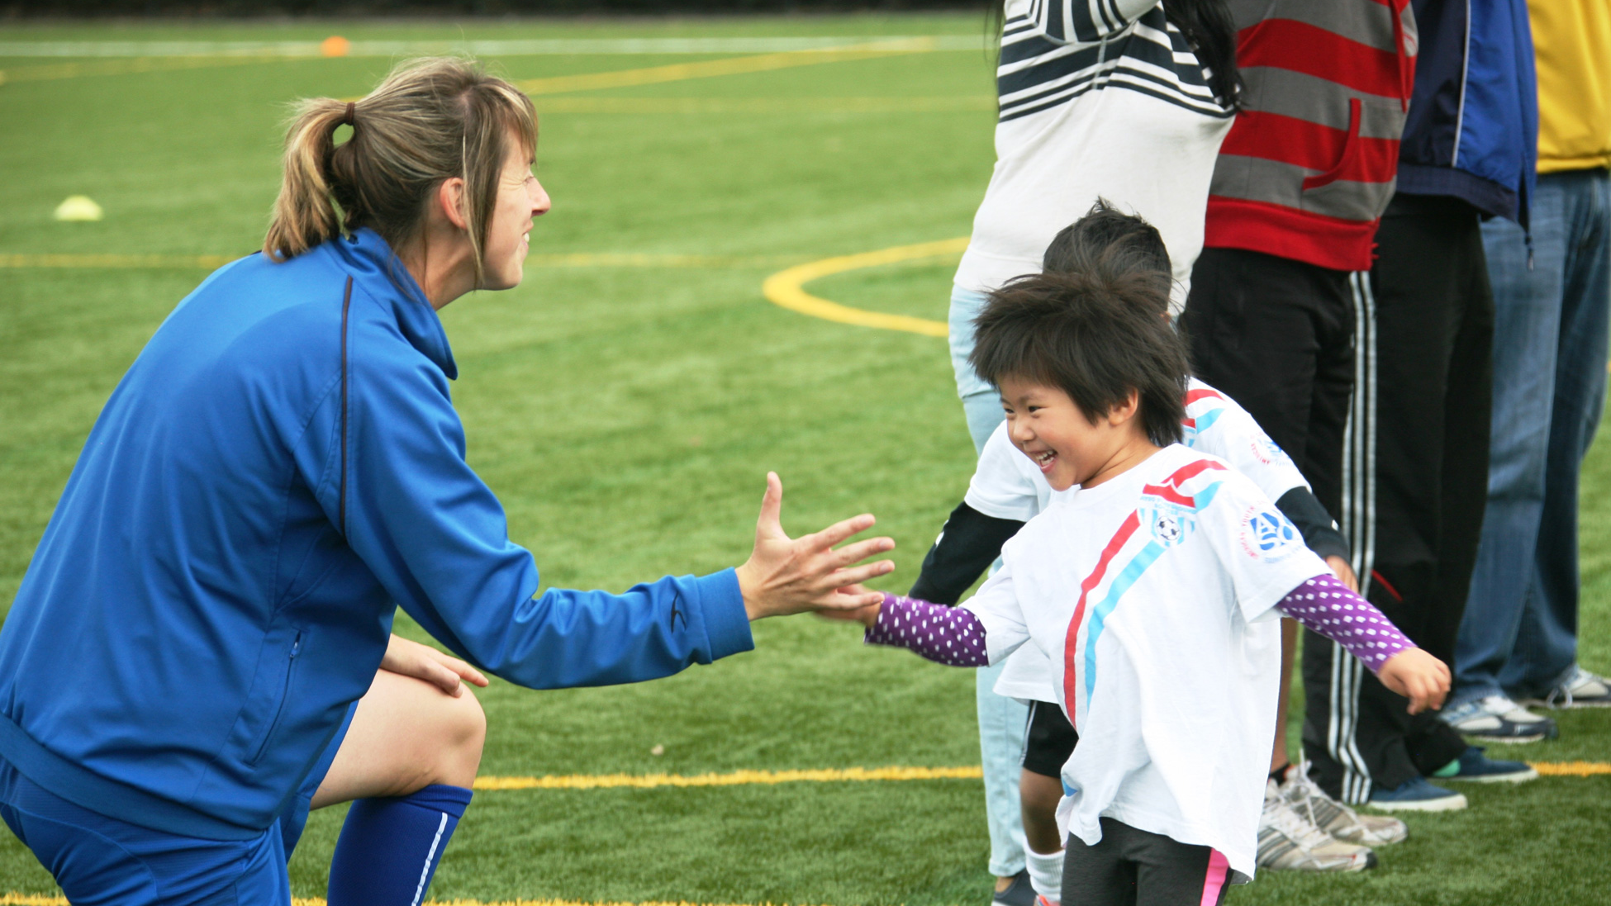
Kickstart is…
AYSO’s entry-level program for young players beginning their soccer journey
It emphasizes play-based learning, parent-child connection, and simple game experiences
Sessions build confidence through movement, fun activities, and small-sided play
It is the starting point in the AYSO journey

Slide 4

What To Expect
Every weekly session includes:
  Fundamental Motor Skill (FMS) Activity
  Game-Like Activity
  The Big Match (modified game play)

Slide 5

Fundamental Motor Skill (FMS) Activity
The first activity always focuses on FMS:
  Locomotor (running, hopping, skipping, etc.)
  Non-locomotor (balancing and twisting, etc.)
  Object Control (catching and throwing, kicking, etc.)
Before children can succeed in soccer, they need the building blocks of movement. Kickstart develops those skills through fun, play-based activities all with a soccer thread.

Slide 6
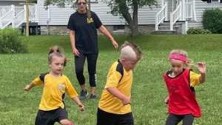
Game Like Activity with SEL Thread
Builds and scaffolds simple soccer skills and game understanding through creative activities
Each session has a social or emotional (SEL) theme carefully
woven in
Helps children begin to understand the game
Keeps learning fun, active, and age-appropriate

Slide 7
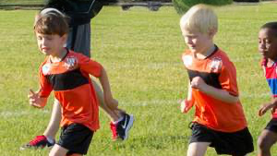
The Big Game
Ends each session with a fun small-sided game
Carefully modified to maximize particpation and fun!
Gives players a chance to use what they learned
4-goals instead of 2! Who doesn't like scoring more goals!
Live Restarts* – parent participation needed to keep the ball rolling and game moving

Slide 8
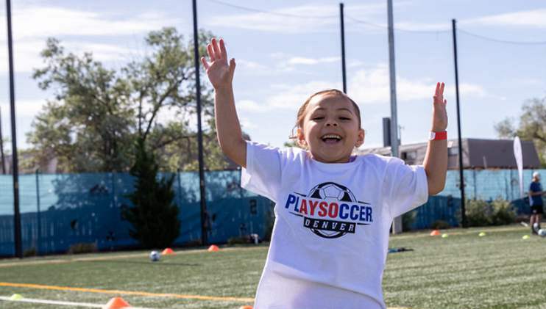
Parents Role
Be Present
Your child shines when they see your smile.
Encourage Effort
Celebrate the try, not just the result.”
Model Positivity
“Your attitude sets the tone.”
Create Memories Together
This is family time, not just soccer time.

Slide 9
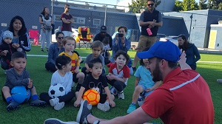
Ways to Get Involved
Become a Game Manager
Step up as an Activity Leader
Help with Live Restarts (keeping the game flowing)
Be a part of set up/ tear down

Slide 10
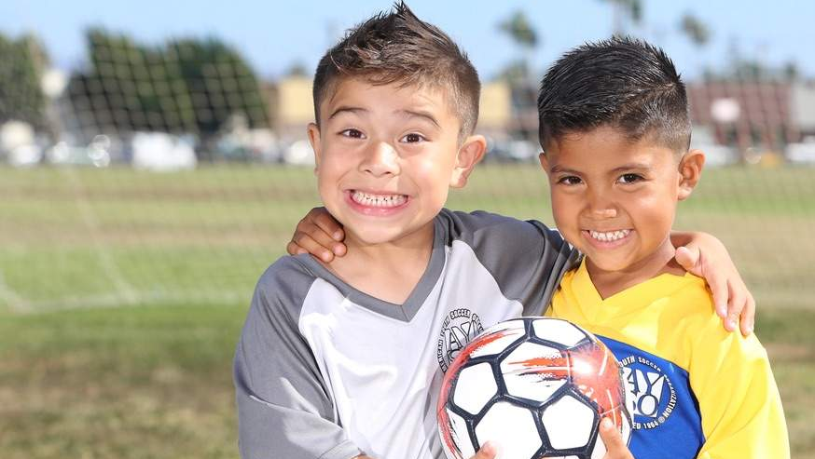
Thank you for saying yes to this adventure with your child. You’re giving your child more than soccer. You’re giving them confidence, joy, and memories to last a lifetime.

