Slide 1


American Youth Soccer Organization
LOCAL SPONSORSHIP OPPORTUNITIES

Slide 2

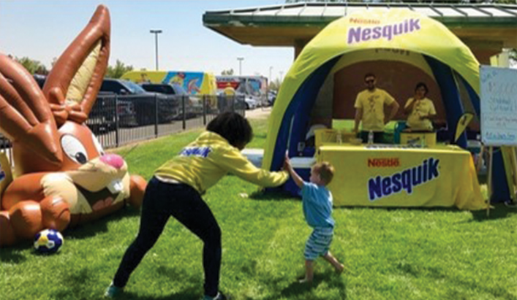

WHY YOU SHOULD PARTNER WITH YOUR LOCAL AMERICAN YOUTH SOCCER ORGANIZATION (AYSO) REGION
AYSO provides a platform for year-round branding and activation with one of the most desirable target audiences. Sponsorship with a local AYSO region could include a mix of traditional and digital media, events, and customized promotional/PR opportunities.
AYSO’s primary demographic is women, aged 25-45. The AYSO Regional Sponsor program can deliver a highly specific sales and marketing package designed to build maximum visibility and sales.
BALANCED TEAMS

Slide 3
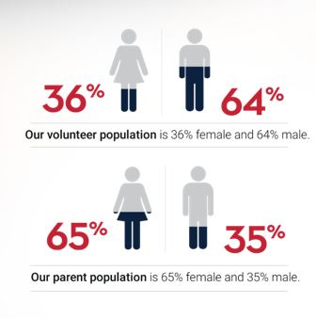
REGION STATISTICS
Please feel free to add any data from your region on this slide. Data may include your registration numbers from both the spring and fall seasons and any other relevant info.
Below is an example of data that you might include for your specific region:
OPEN REGISTRATION

Slide 4

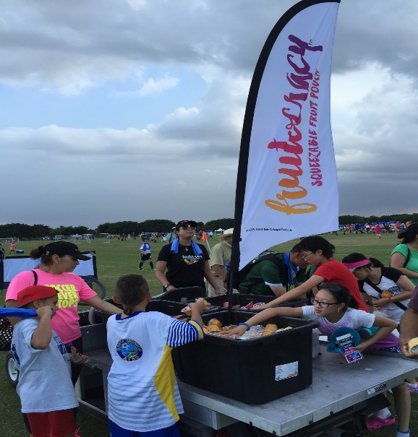
EXPERIENTIAL MARKETING
AYSO provides a tremendous platform for on-site activation opportunities.
Activation opportunities include:
Banners at events
Promotional booth at game days and/or tournaments
Sampling at game days and/or tournaments (food/restaurant properties)
Logo on uniform (sleeve or shorts only)
Presenting sponsorship for specific tournaments or events
POSITIVE COACHING

Slide 5
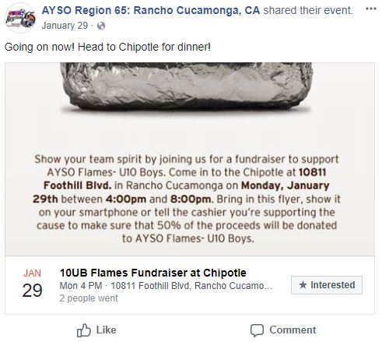
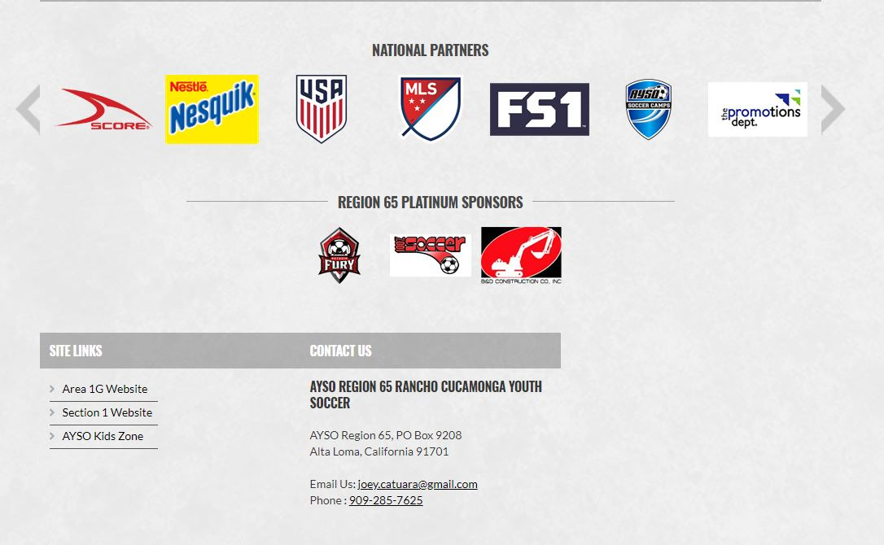
TRADITIONAL AND NEW MEDIA ADVERTISING
Advertising Opportunities Include:
Logo recognition and acknowledgement on region website
Social Media posts
Acknowledgement/recognition in region yearbook
GOOD SPORTSMANSHIP

Slide 6
SPONSORSHIP BENEFITS AND LEVELS
Total Sponsorship Amount (not per year fee) | Amount determined by region | Amount determined by region | Amount determined by region | Amount determined by region | Amount determined by region | Amount determined by region
Tournament Presenting Sponsorship |  |  |  |  |  | X
Use of Region logo |  |  | X | X | X | X
Experiential Marketing:
Event banners | X | X | X | X | X | X
Promotional booth | X | X | X | X | X | X
Sampling opportunities | X | X | X | X | X | X
Uniform logo (sleeve or shorts only) |  |  |  |  |  | X
Advertising:
Acknowledgement/recognition in yearbook | X | X | X | X | X | X
Logo and acknowledgement on region website | X | X | X | X | X | X
Social media | X | X | X | X | X | X
PLAYER DEVELOPMENT

Slide 7
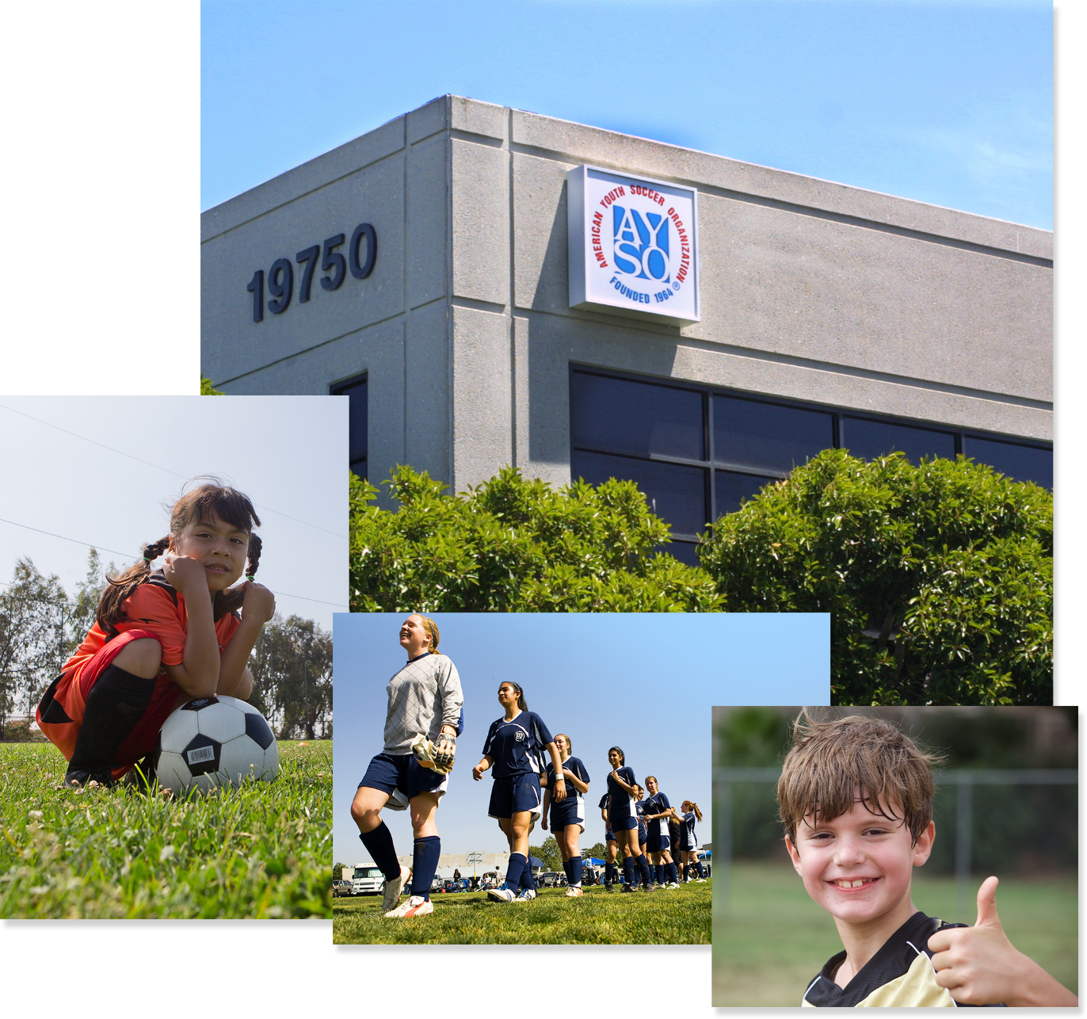
CONTACT INFORMATION
For more information on becoming an AYSO Sponsor in your local region, please contact:
[Region Sponsor Contact Name]
[Region Sponsor Contact Email Address]
[Region Sponsor Contact Phone Number]
[Region Website]

Slide 8


